Slide 1





Basics of working with Linux
Operating System
Notes:
Welcome to the foundation course.
In the first module we'll learn about operating systems.
Among operating systems, Linux based operating systems are the most used operating systems.
So, let's understand what is Linux and how's it different from other operating systems.

Slide 2
Disclaimer
The content is curated from online/offline resources and used for educational purpose only

Slide 3

Learning Objectives
You will learn in this lesson:
Operating System
Linux Operating System
Linux Kernel
Basic Linux Commands
Shell Scripting
Notes:
The content of this lesson includes operating system, linux operating system, linux kernel, basic linux commands and shell scripting.
3

Slide 4
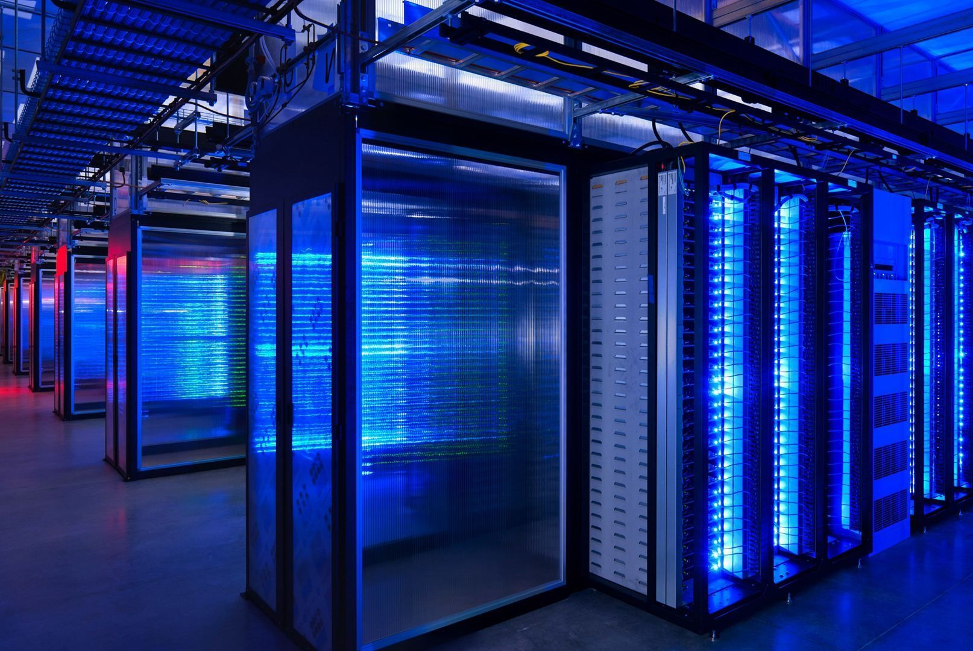

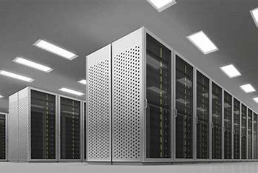

Scenario
Computer Servers
Android Phones
Supercomputers
IoT Devices
Notes:
Before we start today's session tell me have you heard about cloud computer servers, Android phones, supercomputers or IoT devices?
do they have anything in common?
you are guessing it right.
the common element is the operating system which is Linux based operating system.
Do you know Linux is the dominant choice for server environments. It is being used in 70 to 80 percentage of servers.
If you're thinking about supercomputing then over 90 percentage of supercomputers and high processing computing systems use Linux based operating system.
when it comes to Android phones over 70 percentage of mobile phones use Linux based kernels and among IoT devices the usage is around 50 to 60 percentage.
Now you can understand that Linux is one of the most important operating systems. so let's understand more about Linux operating systems in in our session.
Ref:
https://th.bing.com/th/id/R.d71c4b294869641f67f67e971439c30b?rik=H6VhF69ymUSnRQ&riu=http%3a%2f%2fmovietvtechgeeks.com%2fwp-content%2fuploads%2f2015%2f05%2fmost-common-server-problems.jpg&ehk=wnidMUQLTJoWA1kNQ1z23dOqR5CcO%2fC8sby%2fMXLHd1g%3d&risl=&pid=ImgRaw&r=0
https://supplyleader.com/preview_files/179952.jpg
https://th.bing.com/th/id/OIP.z2Vy0EYbH_rv1WhxNXJqQAHaEj?w=269&h=180&c=7&r=0&o=5&dpr=1.3&pid=1.7
https://th.bing.com/th/id/OIP.dBAf5XOGQ0wdpx54u0PV-gHaHa?w=153&h=180&c=7&r=0&o=5&dpr=1.3&pid=1.7
4

Slide 5
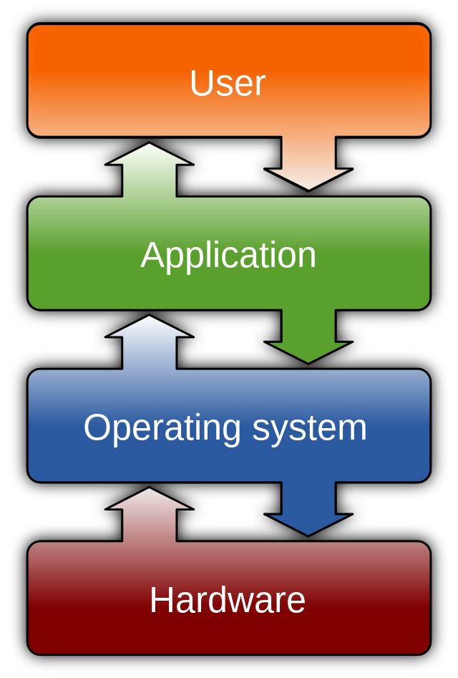
Introduction
Operating System acts as an interface between the computer hardware components and the user.
Performs file management, process management, and memory management, handling input and output devices.
Helps us to communicate with the computer without us having the knowledge of the computer’s language.
Source:
https://upload.wikimedia.org/wikipedia/
Notes:
The operating system acts as an interface between the computer hardware components and the user. It performs all the basic tasks such as file management, process management, and memory management, handling input and output devices. The operating system helps us to communicate with the computer without us having the knowledge of the computer’s language. In short, a computer without an operating system is useless.
5

Slide 6
Operating System Management Tasks
Process Management
Memory
Management
Device
Management
File
Management
Storage
Management
User-Interface
Management
Security
Management
Job-accounting Management
Notes:
**************Note to trainer: Use the following example and analogy to explain the usage and responsibilities of Operating Systems................
Imagine your computer is like a big, busy playground, and the operating system (OS) is like the playground manager. The OS has important jobs to make sure everything runs smoothly.
Traffic Control: The OS makes sure that different programs and apps take turns using the computer's resources, like the swings and slides. This way, no one hogs everything.
Organizing Stuff: It helps organize files and folders, just like arranging your toys neatly. This way, you can find your games, pictures, and homework easily.
Security Guard: The OS acts like a guard, protecting the computer from sneaky viruses and bad stuff that might want to cause trouble.
Talking Translator: It helps different parts of the computer talk to each other, even if they speak different languages. This way, they can work together.
Updates and Cleaning: The OS cleans up junk files, making sure everything stays clean and fast. It also gets updates to learn new tricks and fix problems.
User Helper: It helps you, the computer user, by showing things on the screen, taking your commands, and making sure you have a good time on the playground/computer.
So, the OS is like a helpful playground manager that makes sure everything on the computer works nicely together.
Now, in technical manner, The operating system provides services to programs and the users of the system. The common management tasks that an operating system perform include:
Process management involves putting the tasks in order and pairing them into manageable size, before they go to the CPU.
Memory management consists of coordinating data to and from the Random Access Memory and determines the necessity for virtual memory.
Device management provides an interface between the connected devices.
File management: manages all the file-related activities such as organization storage, retrieval, naming, sharing, and protection of files.
In Storage management: It directs permanent data storage.
User Interface management: allows you to communicate with your computer. It also sees to the coordination and assignment of compilers, interpreters, and another software resource of the various users of the computer systems.
Security management protects the data and information of a computer system against malware threat and authorized access.
Job accounting keeps track of time and resource used by various job and users.
6

Slide 7
Desktop Operating Systems
Mobile Operating Systems
Types Operating System
Embedded Operating Systems
Server Operating Systems
Real-Time Operating Systems
Mainframe Operating Systems
Special-Purpose Operating Systems
Notes:
The main types of operating systems:
Desktop Operating Systems:
Windows: Microsoft's Windows operating system is widely used on personal computers and offers various versions with different features and capabilities.
macOS: Apple's macOS is used on Macintosh computers and is known for its user-friendly interface and integration with Apple's ecosystem.
Linux: Linux is an open-source operating system kernel that serves as the basis for many different distributions (distros) that cater to different user preferences and needs.
Mobile Operating Systems:
Android: Developed by Google, Android is the most popular mobile operating system globally, powering a wide range of smartphones and tablets.
iOS: Apple's iOS is exclusive to iPhones, iPads, and iPod Touch devices, known for its sleek design and tight integration with Apple services.
Server Operating Systems:
Linux: Many servers run various Linux distributions due to their stability, security, and customizability. Examples include Ubuntu Server, CentOS, and Red Hat Enterprise Linux.
Windows Server: Microsoft offers server versions of its Windows operating system tailored for enterprise-level tasks and applications.
Embedded Operating Systems:
RTOS (Real-Time Operating Systems): These are used in embedded systems where tasks need to be executed within specific time constraints. Examples include FreeRTOS and QNX.
Embedded Linux: A trimmed-down version of Linux optimized for embedded devices, offering flexibility and customization options.
Real-Time Operating Systems (RTOS):
RTOS: These are designed for systems where real-time processing is crucial, such as in industrial automation, robotics, and aerospace applications. Examples include VxWorks and eCos.
Mainframe Operating Systems:
z/OS: IBM's z/OS is designed for mainframe computers, emphasizing high performance, reliability, and security.
Special-Purpose Operating Systems:
Chrome OS: Developed by Google, Chrome OS is designed for lightweight laptops called Chromebooks, relying heavily on cloud-based applications.
KIOSK OS: Operating systems designed for self-service kiosks, ATMs, and other specialized machines.
In almost all the categories, you can see at least one flavour of Linux.
7

Slide 8

What is Linux?
The Linux OS is free and open-source and behaves like a Unix-like operating system.
Linux was conceived and created in 1991 by Linus Torvalds for his i386-based PC
Linux was adopted as the kernel for the GNU operating system, which was created as a free replacement for UNIX.
Notes:
***********Note to trainer: Let the students understand the story and then go with technical details.**********************
So, this brings us to Linux. But, what is Linux?
Linus Trovalds started this project in 1991 when he was a young student in Finland. He named his project "Linux" by combining his name with the word "Unix," which is also a type of operating system. He didn't do it all alone; he put his project on the internet and asked other programmers to help. They liked his idea and joined in.
Day by day, programmers from all around the world joined the effort. They wrote pieces of code, like building blocks, that made the operating system better and stronger. They shared their work, discussed ideas, and fixed problems together.
People loved Linux because it was free to use and could run on many types of computers. It became like a big, friendly community of computer enthusiasts. Over time, Linux grew and improved, becoming really powerful and popular. It's used not only on computers but also in things like smartphones, servers, and even in space exploration!
And that's the story of Linux – how a young programmer's idea turned into a global collaboration that created a fantastic operating system that many people still use and enjoy today.
The Linux OS is free and open-source and behaves like a Unix-like operating system. . An operating system is said to be Unix-like if it supports multiple users, has a hierarchical file system, and behaves similar to UNIX Operating System based on the Linux kernel.
Linux was conceived and created in 1991 by Linus Torvalds for his i386-based PC, and it was soon adopted as the kernel for the GNU operating system, which was created as a free replacement for UNIX.
8

Slide 9
Linux Features
UNIX-like kernel.
Open source.
Preemptive multitasking
Portable
Security
Notes:
Linux is a Unix clone, behaves like Unix but doesn't contain its code. It has the following features
Open source: Linux operating system source code is available freely and for enhancing the capability of the Linux OS, several teams are performing in collaboration.
Preemptive multitasking is task in which a computer operating system uses some criteria to decide how long to allocate to any one task before giving another task a turn to use the operating system.
Portable: Linux OS can perform different types of hardware and the kernel of Linux supports the installation of any type of hardware environment.
Security: Linux OS facilitates user security systems with the help of various features of authentication such as controlled access to specific files, password protection, or data encryption.

Slide 10
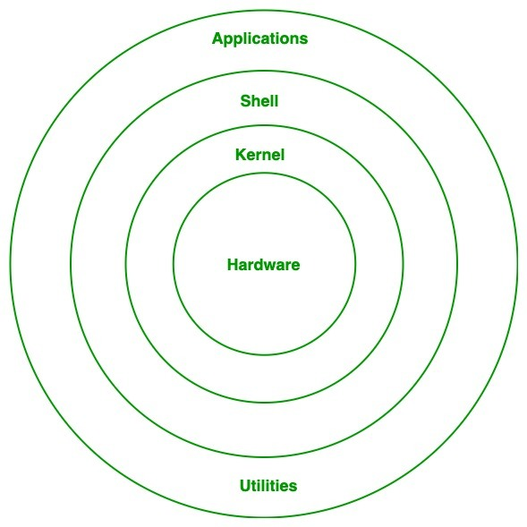
Linux Architecture
Hardware Layer
Kernel
Shell
Utilities
Source:
https://media.geeksforgeeks.org/wp-content/uploads/
Notes:
The architecture of Linux operating system mainly consists of the following components:
Hardware layer:- Linux operating system contains a hardware layer that consists of several peripheral devices like cpu, hdd and ram
Kernel: The kernel is one of the core section of an operating system. It is responsible for each of the major actions of the Linux Operating System. Linux contains distinct types of modules and cooperates with underlying hardware directly. The kernel is also responsible for preventing and mitigating conflicts between different processes.
Shell:- It is an interface among the kernel and user. It can afford the services of kernel. It can take commands through the user and runs the functions of the kernel. The shell is available in distinct types of Operating Systems. These operating systems are categorized into two different types, which are the graphical shells and command-line shells
Utility Programs:- It is responsible for doing specialized level and individual activities. It provides the functionalities of an operating system to the user

Slide 11
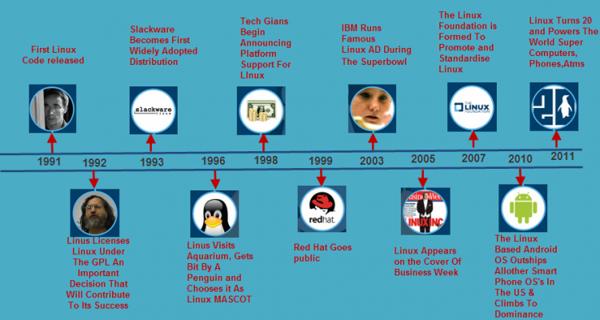
History of Linux
Source:
OIP.ogHRO_lpdj0EunHjowo3HwAAAA (474×252) (bing.com)
Notes:
The History of Linux began in 1991 with the beginning of a personal project by a Finland student Linus Torvalds to create a new free operating system kernel.
In 1992 Linus Torvald changed the Linux copyright license to GNU General Public License, which is a free, copyleft license as opposed to expensive UNIX
Slackware, the basis for other Linux distributions was created in 1993
Torvald was bitten by a penguin in 1996 at Australia National Zoo, leading to Tux as a official logo for Linux
Red Hat's initial public offering took place in 1999, and 2003 marked the first commercial of Linux by IBM aired during Super Bowl.
Linux becomes popular and appears on the cover of business week in 2005, whereas 2007 marks the birth of Linux Foundation, dedicated to fostering the growth of Linux. Dell starts distributing Laptops with Ubuntu pre-installed in it.
Android, a modified version of Linux kernel dominates the smart phone market in 2010, and by 2011 Linux becomes the undisputed king of supercomputing.

Slide 12






Linux Distributions
Ubuntu
Debian
Fedora
Kali Linux
Arch Linux
Raspberry Pi OS
Notes:
A Linux distribution, is an operating system compiled from components developed by various open source projects and programmers. Each distribution includes the Linux kernel , the GNU shell utilities, the desktop environment, a package management system, an installer and other services. Many components are developed independently from each other and are distributed in source code form. Linux being open source software, anyone can make their own Linux distribution by assembling it from the source code themselves, or by modifying an existing distribution. Currently, more than 300 Linux distributions are actively maintained. We list here some of the most commonly used distributions like
Ubuntu
Debian
Fedora
Kali Linux
Arch Linux
Raspberry Pi

Slide 13

Lab 1: Installing Linux on VirtualBox
Notes:
This brings us to the first lab. In this session, we will discuss how to install linux on a virtualbox. We will understand how to download Oracle VirtualBox as well as Ubuntu Operating system. Let's move ahead with this first Lab session.

Slide 14
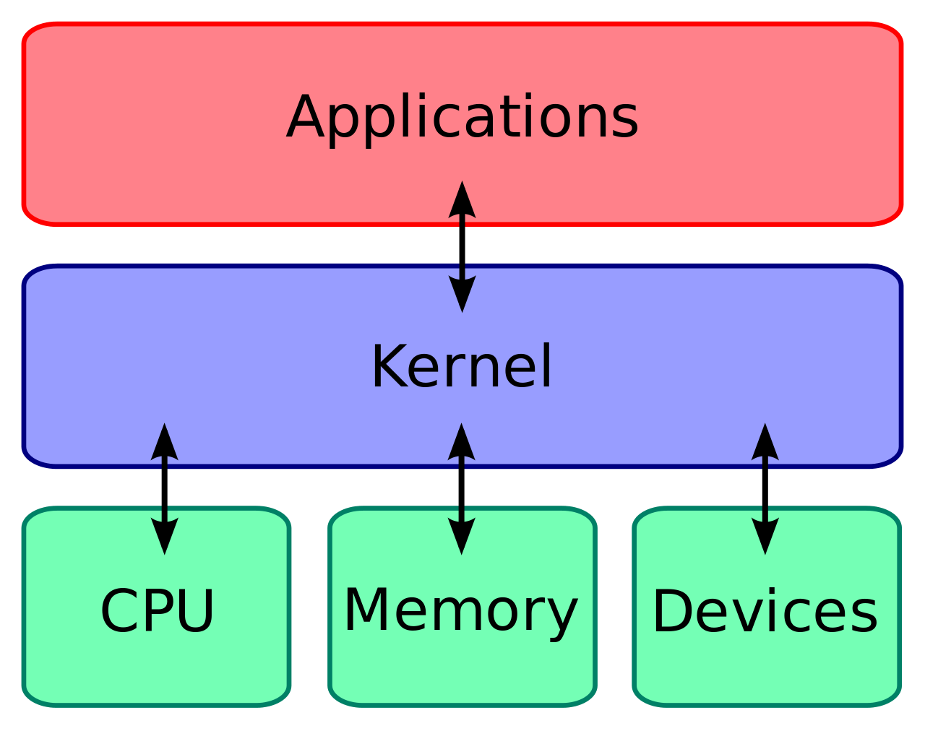
What is a Linux Kernel?
Kernel runs each processes and provides system services to processes, provides protected access to hardware to processes.
The kernel has the following jobs:
Memory management
Process management
Device drivers
System calls and security
Source:
https://blog.digilentinc.com/wp-content/uploads/2015/05/1280px-Kernel_Layout.svg_.png
Notes:
The kernel manages the computer's hardware, which are the parts inside the computer that make it work, like the screen, keyboard, and memory. It also helps different programs (like games or web browsers) talk to these hardware parts and share resources nicely, so every process gets a fair turn to use them.
It is the main component of a Linux operating system and is the core interface between a computer’s hardware and its processes. The Kernel runs each processes and provides system services to processes, provides protected access to hardware to processes.
The kernel has the following jobs:
Memory management: It Keeps track of how much memory is used to store what, and where
Process management: It Determines which processes can use the central processing unit (CPU), when, and for how long
Device drivers: It Acts as mediator/interpreter between the hardware and processes
System calls and security: It Receives requests for service from the processes

Slide 15
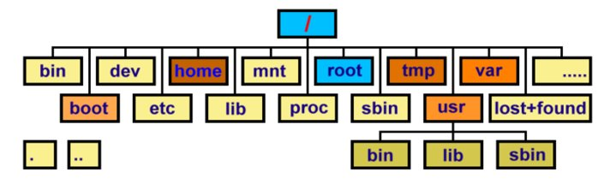
Linux File System​​
The kernel maintains a single hierarchical directory structure to organize all files in the system. In Microsoft Windows, each disk device has its own directory hierarchy.​
Notes:
At its core, the Linux file system is the hierarchical structure and set of protocols that manage how data is stored, organized, and accessed on a Linux-based operating system. It establishes the rules for naming, storing, and retrieving files and directories on various storage devices, such as hard drives and solid-state drives.
The Linux file system is based on a tree-like structure, starting from a single root directory ("/") and branching out into subdirectories. Each directory can contain files and more subdirectories, forming a logical organization of data. This structure allows for efficient management of data, as well as providing a clear path for locating files and directories.

Slide 16
Important Directories (Linux File System)​
In a Linux file system, there are several important directories that serve specific purposes and hold essential system and user data.
1. **/** (Root Directory)
2. **/bin (Binary Binaries)
3. **/etc (System Configuration Files)
4. **/home (User Home Directories)
5. **/usr (User Binaries and Libraries)
6. **/var (Variable Files)
7. **/tmp (Temporary Files)
8. **/dev (Device Files)
9. **/boot (Boot Loader Files)
10. **/opt (Optional Software)
Notes:
In a Linux file system, there are several important directories that serve specific purposes and hold essential system and user data. 10 important directories in the Linux file system:
1. **/** (Root Directory): This is the top-level directory from which all other directories and files branch out. It contains everything in the system, and its primary purpose is to provide a starting point for the entire file system hierarchy.
2. **/bin (Binary Binaries):** This directory contains essential system binaries (executable files) that are needed for the system to function even during single-user mode or when other file systems aren't mounted yet. These binaries are critical for basic system operations.
3. **/etc (System Configuration Files):** The "etc" directory holds configuration files for the system and various applications. It contains settings that control how different software and services behave on the system.
4. **/home (User Home Directories):** Each user on the system has a corresponding subdirectory within "/home" where they can store their personal files, documents, settings, and configurations. This is typically the main storage area for user-specific data.
5. **/usr (User Binaries and Libraries):** The "usr" directory contains user-related binaries, libraries, documentation, and other data not required for initial system booting. It's divided into subdirectories like "/usr/bin" for user executables and "/usr/lib" for shared libraries.
6. **/var (Variable Files):** This directory holds variable data files, including log files, temporary files, spool directories (for print queues and mail), and other data that may change frequently during system operation.
7. **/tmp (Temporary Files):** The "/tmp" directory is used to store temporary files created by various applications and users. These files are typically removed when the system reboots, helping to maintain system cleanliness.
8. **/dev (Device Files):** The "dev" directory contains special device files that represent physical and virtual devices on the system. These files allow programs to interact with hardware and perform I/O operations.
9. **/boot (Boot Loader Files):** The "/boot" directory holds files necessary for the system's boot process, including the kernel image, initial RAM disk (initramfs), and boot loader configuration files.
10. **/opt (Optional Software):** The "opt" directory is used for installing optional or third-party software packages. Software installed here is usually self-contained and does not integrate deeply into the system's default directories.
These directories play crucial roles in organizing system data, configuration, user files, and executable binaries. Understanding their purposes can help users and administrators navigate the Linux file system more effectively.

Slide 17
ls command
ls -a (all) Lists all the files (including .* files) | ls -S (size) Lists the biggest files first
ls -l (long) Long listing (type, date, size, owner, permissions) | ls -r (reverse) Reverses the sort order
ls -t (time) Lists the most recent files first | ls -ltr (options can be combined) Long listing, most recent files at the end
Lists the files in the current directory, in alphanumeric order, except files starting with the “.” character
Notes:
The ls command is a fundamental command in Unix-like operating systems, including Linux. It stands for "list" and is used to display the contents of a directory. When you run the ls command without any additional options or arguments, it provides a listing of the files and subdirectories in the current directory.

Slide 18
cd and pwd commands
cd <dir> Changes the current directory to <dir>.
cd - Gets back to the previous current directory.
pwd Displays the current directory ("working directory").
Notes:
CD is used for changing directory.
PWD is used to display present working directory.

Slide 19
cp command
cp <source_file> <target_file> Copies the source file to the target.
cp file1 file2 file3 ... dir Copies the files to the target directory (last argument).
cp -i (interactive) Asks for user confirmation if the target file already exists
cp -r <source_dir> <target_dir> (recursive) Copies the whole directory.
Notes:
CP used for Coping file from one location to the other, that is from source to target.

Slide 20
mv and rm commands
mv <old_name> <new_name> (move) Renames the given file or directory.
mv -i (interactive) If the new file already exits, asks for user confirm
rm file1 file2 file3 ... (remove) Removes the given files.
rm -i (interactive) Always ask for user confirm.
rm -r dir1 dir2 dir3 (recursive) Removes the given directories with all their contents.
Notes:
Mv is move and rm is remove
As the names suggest, move command is use move things, pretty much like cut and paste.
RM removes the file and directory.
With both these commands, you can use various arguments to add more customizations, as displayed on the screen.

Slide 21
Creating and Removing Directories
mkdir dir1 dir2 dir3 ... (make dir) Creates directories with the given names.
rmdir dir1 dir2 dir3 ... (remove dir) Removes the given directories
Safe: only works when directories and empty. Alternative: rm -r (doesn't need empty directories).
© Edunet Foundation. All rights reserved.
Notes:
Mkdir means make directories.
Rmdir means remove directories.
These commands work only with directories and not with files.

Slide 22
Lab 2: Operating Linux Using Terminal
Notes:
We have seen Linux has some interesting features. One of the most important part is operating an operating system directly from command line interface, which makes it as the best choice for server OS. So, in this session, we will understand how to use Terminal for this.

Slide 23
Working with Files
command​ | function ​
touch filename1 fileName2 fileName3 ….​ | easy way to create a file​
cp file1 file2 or cp fileName filePath​ | copy content of a file to other file​
mv fileName1 fileName2 or mv fileName1 filePath/dirPath​ | move file content or file to other dir​
cp -r dirName1 dirName2​ | recursive copy​
cp file1 file2 file3 file4 file5 /dirName​ | cp multiple files to directory​
head​ | display first 10 lines​
tail​ | display last 10 lines ​
cat ​ | display content​
cat > fileName​ | create file with concatenated content (ctrl+d for EOL)​
Notes:
These are a few commands which you can practice on terminals.
Touch command create a new file with a name supplied with command itself.
Cp copies the file from source to target location.
Mv cuts and paste to target location.
Head displays first 10 lines of the file.
Tail displays last10 lines of the file.
Cat displays the whole content.

Slide 24
File Access Rights
Use ls -l to check file access rights
3 Types of Access Rights:
Read access (r)
Write access (w)
Execute rights (x)
3 Types of Access Levels:
User (u): for the owner of the file
Group (g): each file also has a “group” attribute, corresponding to a given list of users
Others (o): for all other users
© Edunet Foundation. All rights reserved.
Notes:
File access allows user to change access rights on file.
There are three types of accesses. READ, WRITE and EXECUTE.
These accesses are provided to three categories of like user, group and other defined by u, g and o.

Slide 25
Access Right Examples​
-rw-r--r-- Readable and writable for file owner, only readable for others
-rw-r----- Readable and writable for file owner, only readable for users belonging to the file group.
drwx------ Directory only accessible by its owner
-------r-x File executable by others but neither by your friends nor by yourself. Nice protections for a trap...
Notes:
These are some of the examples for your reference.
Don't worry we are going to practice all these in our upcoming hands-on session.

Slide 26
Lab 3: Practicing File Operations
Notes:
Moving ahead, let's see how to operate on file. We will understand how to use both GUI as well as CLI for these operations in this hands-on session. We will also practice how to modify access rights.

Slide 27
Shell Scripting
Notes:
Now let's start with Shell Scripting.

Slide 28
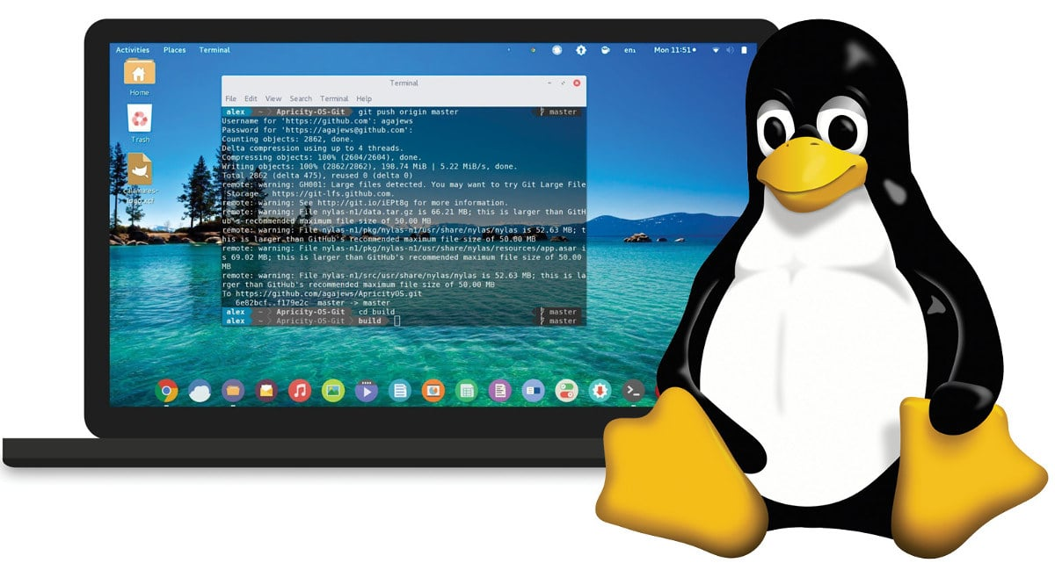
What is a Shell ?
A shell is an environment that takes commands typed by the user and calls the operating system to run those commands.
It is a program that acts as the interface between the user and the Linux system, allowing the user to enter commands for the operating system to execute.
Shell accepts the instruction or commands in English and translates them into computers native binary language.
Source:
https://www.opensourceforu.com/2020/03/reasons-to-use-linux/
Notes:
A shell is a program that takes commands typed by the user and calls the operating system to run those commands. It is a program that acts as the interface between the user and the Linux system, allowing the user to enter commands for the operating system to execute.
Shell accepts the instruction or commands in English and translate it into computers native binary language

Slide 29
Kind of Shells
Kind of Shells
Bourne Shell
C Shell
Korn Shell
Bash Shell
Tcsh Shell
Notes:
There are different kinds of shells, and we are free to run any shell of our choice depending on the task. Here we list some of the frequently used shells
1) The Bourne shell also known as sh is available by default on almost all the UNIX like operating system. The Basic bourne shell supports only the most limited command line editing.
2) The C shell was designed by Bill Joy and is so named because much of its syntax parallels that of C programming language.
3) The Korn shell was created by David Korn and offers the same kind of enhancements as the C shell with a few differences.
4) Bash offers command-line editing like the korn shell,file name completion like the C shell and a lot of other advance features. In Linux, bash is the default shell
5) The T C shell extends the traditional csh to add command line editing, file name completion and more. This shell will complete the file and directory names when you press Tab key

Slide 30
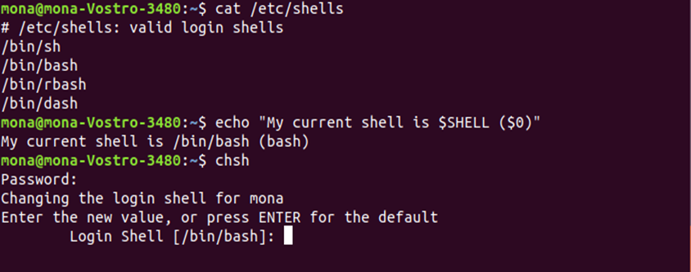
Changing Your Default Shell
Command to find all available shells in your system: $ cat /etc/shells
The basic Syntax to change your default shell : $ chsh username new_default_shell
Notes:
We list here the commands which will help you to find all the available shells in your system, command to find your current shell and change the shell using the C H S H command

Slide 31

Shell Scripting
Shell script is a plain text file that contains a series of command(s).
Shell script takes input from user, file and output them on screen.
It saves lots of time by automating routine admin tasks.
Notes:
The shell as we know is the operating system command line interface and interpreter for the set of commands that are used to communicate with the system. A shell script is a text file that contains a sequence of commands for a UNIX-based operating system. It is called a shell script because it combines a sequence of commands, that would otherwise have to be typed into the keyboard one at a time, into a single script.

Slide 32
Why to use Shell Script?
Shell scripts can be used to automate administrative tasks.
Encapsulate complex configuration details and get a full power of the operating system.
The ability to combine commands allows you to create new commands, thereby adding value to your operating system.
Notes:
Shell script is mostly useful for repetitive tasks that may be time-consuming to execute by typing one line at a time. It is used to encapsulate complex configuration details and get at the full power of the operating system. The ability to combine commands allows you to create new commands, thereby adding value to your operating system.

Slide 33
Practical Examples of Shell Scripting
Monitoring the Linux system.
Data backup and creating snapshots.
Find out what processes are eating up your system resources.
Find out available and free memory.
Find out all logged in users and what they are doing.
Find out if all necessary network services are running or not.
Notes:
Shell Scripting can be used for Monitoring the Linux system, doing Data backup and creating snapshots. It can be used to find out what processes are eating up your system resources.
We can use shell script to find out available and free memory and also Find out all logged in users and what they are doing. It is also used to Find out if all necessary network services are running or not.

Slide 34
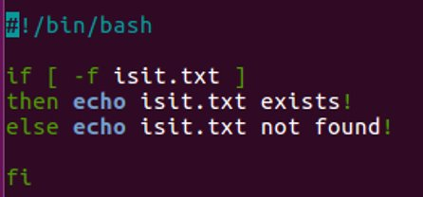
Practical Examples:
write a shell script to use if then else​
​
#!/bin/bash​
if [ -f isit.txt ]​
then echo isit.txt exists!​
else echo isit.txt not found!​
fi​
Notes:
Look at this example script.
With your experience suggest what is happening ? what this script will do?
**************** trainer should ask students about their understanding on the script************
Well, basically this script will check if the file named as isit.txt exist or not.

Slide 35
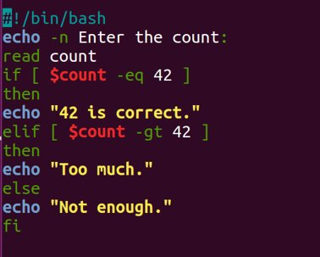
Practical Examples: if then elif​
You can nest a new if inside an else with elif.​
​
#!/bin/bash​
echo -n Enter the count:​
read count​
if [ $count -eq 42 ]​
then​
echo "42 is correct."​
elif [ $count -gt 42 ]​
then​
echo "Too much."​
else​
echo "Not enough."​
fi
Notes:
What is your opinion about this script?
this is an example how you can use a nested if else using elif.

Slide 36
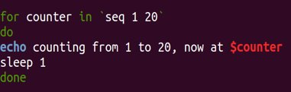
Practical Examples: for loop
#!/bin/bash​
for counter in `seq 1 20`​
do​
echo counting from 1 to 20, now at $counter​
sleep 1​
done​
another way:​
#!/bin/bash​
for i in 1 2 4​
do​
echo $i​
done
Notes:
This program will print the numbers between 1 to 20 with a sleep interval.

Slide 37
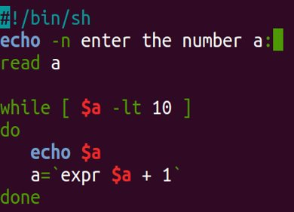
Practical Examples: the while loop
while command​
do​
Statement(s) to be executed if command is true​
done​
​
#!/bin/sh​
a=0​
while [ $a -lt 10 ]​
do​
echo $a​
a=`expr $a + 1`​
done
Notes:
You might have used while statements in your programming. while statement continue to work as long as the condition is met.
this is script uses while statement

Slide 38
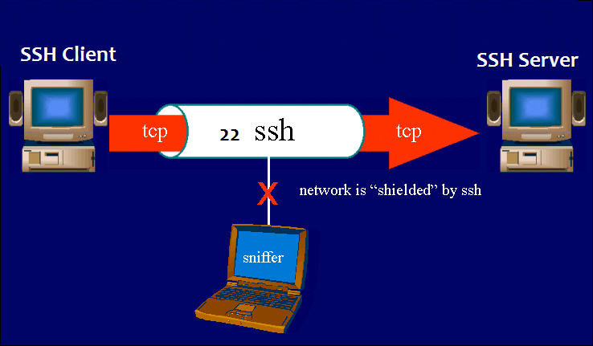
SSH
SSH stands for “Secure Shell”.
SSH transfers the data in encrypted form between the host and the client.
It transfers inputs from the client to the host and relays back the output. SSH runs at TCP/IP port 22
ssh user_name@host(IP/Domain_name
Example: ssh root@192.168.1.1
Notes:
Before we start the practical on shell script, let us first understand two important commands S S H and S S C.
SSH stands for “Secure Shell”. It is a protocol used to securely connect to a remote server/system.
SSH is secure in the sense that it transfers the data in encrypted form between the host and the client.
It transfers inputs from the client to the host and relays back the output. SSH runs at TCP/IP port 22

Slide 39
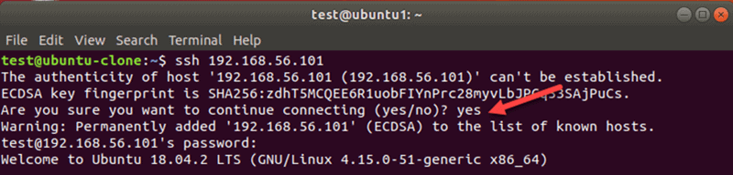
SSH
https://phoenixnap.com/kb/linux-ssh-commands
Notes:
This is a sample screenshot where a computer is being used to connect to a target computer
the IP address of target computer is used along with SSH command.

Slide 40
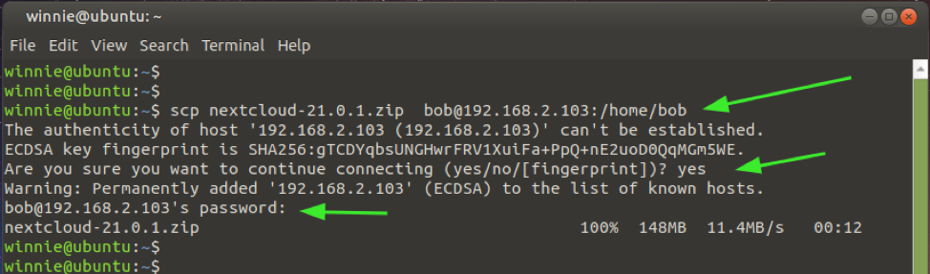
SCP
The scp command allows you to copy files over ssh connections.
This is pretty useful if you want to transport files between computers
Syntax
scp examplefile yourusername@yourserver:/home/yourusername/
Example
scp file1.pdf root@192.168.1.1:/root/Desktop
Notes:
SCP stands for secure copy.
this copy works over as a SSH connection.
Assume that you want to share a file from your computer to the target computer. but you don't have encryption algorithm.
in such a case you can use SSC. all you have to know is target IP address along with valid username and password.

Slide 41
Lab 4: Shell Scripting and Operations
Notes:
Shell scripting enables automation. We have seen some of the examples. Now, let's move ahead do practical sessions on this.

Slide 42

Summary
We know about the basic of Linux operating systems​
We are now familiar with basic Linux commands including the Linux command line, Linux servers, file systems, and much more.​
We know about Linux Terminal, and shell scripting.
Notes:
Summary
We learned about the basic of Linux operating systems
You are now familiar with basic linux commands including the linux command line, linux servers, file systems, and much more.
The students now know about Linux Terminal, and shell scripting.

Slide 43

Quiz
1. Who founded Linux Kernel?
Ken Thompson and Dennis Ritchie
Linus Torvalds
Linus Torvalds and Ken Thompson
Richard Stallman
Answer: b
Linus Torvalds
Notes:
1. Who founded Linux Kernel?
Ken Thompson and Dennis Ritchie
Linus Torvalds
Linus Torvalds and Ken Thompson
Richard Stallman
Correct answer is B Linus Torvalds

Slide 44
Quiz
2. Which symbol represents the top-level directory?
~
@
#
/
Answer: d
/
Notes:
Which symbol represents the top-level directory?
~
@
#
/
Correct answer is D. /

Slide 45
Quiz
3. Which symbol represents the user's home directory?
~
@
#
/
Answer: a
~
Notes:
Which symbol represents the user's home directory?
~
@
#
/
Correct answer is A. ~

Slide 46
References
https://en.wikipedia.org/wiki/Linux_kernel
https://www.tutorialspoint.com/operating_system/os_linux.html
https://buildmedia.readthedocs.org/media/pdf/lym/latest/lym.pdf
https://phoenixnap.com/kb/linux-commands-cheat-sheet
https://www.guru99.com/file-permissions.html
https://www.hostinger.in/tutorials/linux-commands

Slide 47
Thank You

